Slide 1
Machine Learning - Project 3
Joseph Bieselin – JAB975@nyu.edu

Slide 2
Goal
Improve upon a LASSO regression model by using Ridge Regression or Elastic Net
Dataset is from Kaggle’s Titanic competition
Various information about passengers that boarded the Titanic
Prepare dataset for use in R
Use LASSO Regression for analysis
Use Ridge Regression and Elastic Net for further analysis
Compare the results
Results will be used to see if a passenger would have survived the shipwreck

Slide 3
Required Packages
glmnet
ROCR

Slide 4
Data Preparation – read in file
data <- read.csv("http://christianherta.de/lehre/dataScience/machineLearning/data/titanic-train.csv",header=T)

Slide 5
Data Preparation – remove invalid contents
data <- data[,c(2,3,5,6,10)]
data <- data[complete.cases(data),]

Slide 6
Data Preparation – training/testing sets
set.seed(101)
testing <- sample(714, 200, replace=FALSE)
traindata <- data[-testing, ]
testdata <- data[testing, ]
dim(traindata) # 514 5
dim(testdata) # 200 5

Slide 7
Data Analysis – look at some of the data
prop.table(table(traindata$Sex))
# female male
# 0.3618677 0.6381323
prop.table(table(traindata$Survived))
# 0 1
# 0.5894942 0.4105058
prop.table(table(traindata$Sex, traindata$Survived))
# 0 1
# female 0.08949416 0.27237354
# male 0.50000000 0.13813230

Slide 8
Data Analysis – setup training and testing data
traindata.factored <- traindata
traindata.factored$Sex <- as.numeric(traindata.factored$Sex)
testdata.factored <- testdata
testdata.factored$Sex <- as.numeric(testdata.factored$Sex)

Slide 9
LASSO Regression

Slide 10
Data Analysis – LASSO models
# get the LASSO model
lasso.model <- glmnet(as.matrix(traindata.factored[,2:5]), as.matrix(traindata.factored[,1]), family="binomial", alpha=1)
# get cross-validated LASSO model to estimate the optimal lambda
cv.lasso.model <- cv.glmnet(as.matrix(traindata.factored[,2:5]), as.matrix(traindata.factored[,1]), family="binomial", alpha=1)
# estimated optimal lambda
cv.lasso.model$lambda.min # 0.00245966

Slide 11
Data Analysis – viewing model plots
plot(lasso.model, label=TRUE)

Slide 12
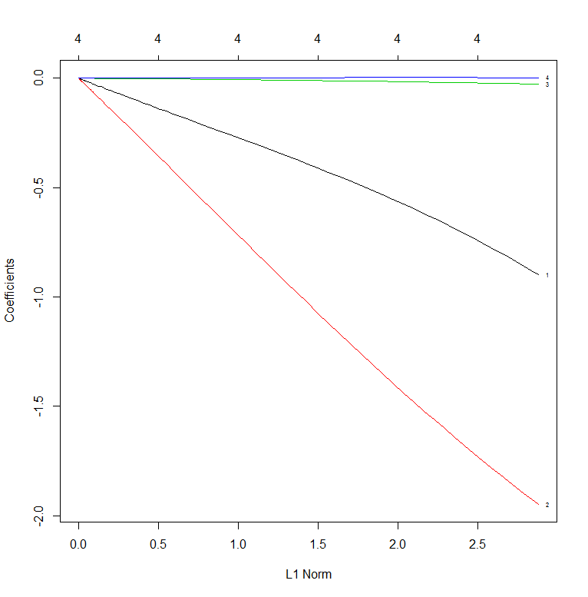
Data Analysis – lasso.model

Slide 13
Data Analysis – viewing model plots
plot(cv.lasso.model)

Slide 14
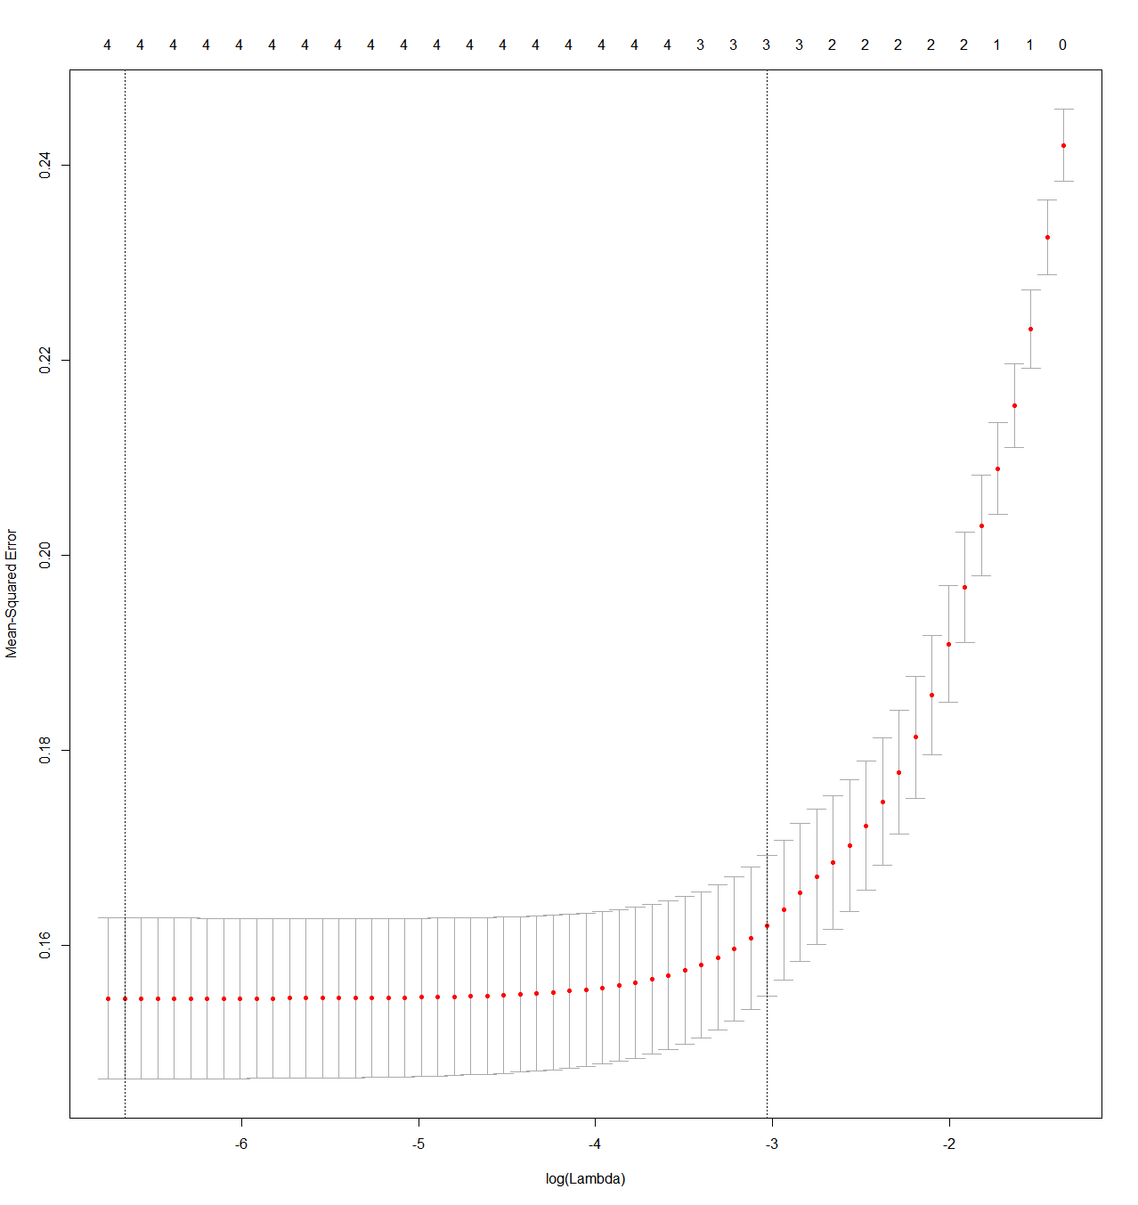
Data Analysis – cv.lasso.model

Slide 15
Data Analysis – setup prediction models
auc.cv.lasso.model <- cv.glmnet(x = as.matrix(traindata.factored[,2:5]), y = as.matrix(traindata.factored[,1]), family="binomial", alpha=1, type.measure="auc")
test.prob <- predict(auc.cv.lasso.model, type="response", newx = as.matrix(testdata.factored[,2:5]), s = 'lambda.min')

Slide 16
Data Analysis – AUC performance
pred.auc <- prediction(test.prob[,1], testdata.factored[,1])
# obtain the false positive and true positive rate of the prediction
cv.lasso.auc.fp <- slot(pred.auc, "fp")
cv.lasso.auc.tp <- slot(pred.auc, "tp")
cv.lasso.fpr <- unlist(cv.lasso.auc.fp) / unlist(slot(pred.auc, "n.neg"))
cv.lasso.tpr <- unlist(cv.lasso.auc.tp) / unlist(slot(pred.auc, "n.pos"))
cv.lasso.perf.auc = performance(pred.auc, "auc")
cv.lasso.auc <- cv.lasso.perf.auc@y.values[[1]]
# plot the ROC curve
plot(cv.lasso.fpr, cv.lasso.tpr, main="ROC Curve from cross-validated LASSO regression", xlab="False Positive Rate", ylab="True Positive Rate")
# label the AUC on the plot for easy viewing
text(0.4, 0.6, paste("LASSO AUC = ", format(cv.lasso.auc, digits=5, scientific=FALSE)))

Slide 17
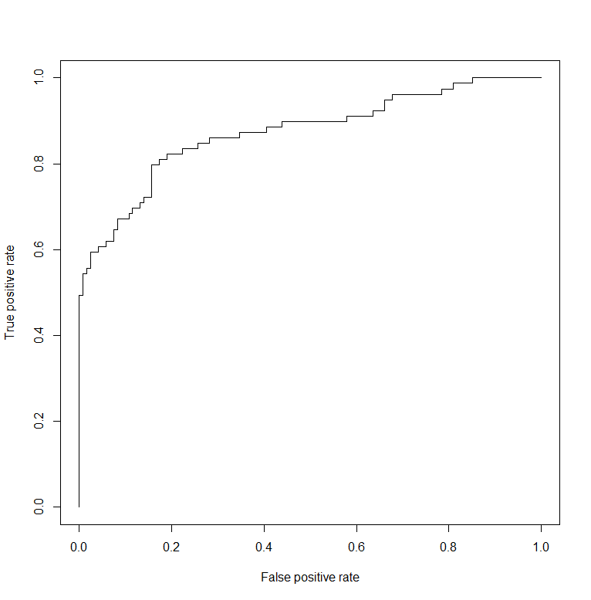
Data Analysis – AUC for auc.cv.lasso.model

Slide 18
Ridge Regression

Slide 19
Data Analysis – Ridge models
# get the Ridge model
# NOTE: alpha=0 (alpha=1 in LASSO)
ridge.model <- glmnet(as.matrix(traindata.factored[,2:5]), as.matrix(traindata.factored[,1]), family="binomial", alpha=0)
# get cross-validated Ridge model to estimate the optimal lambda
cv.ridge.model <- cv.glmnet(as.matrix(traindata.factored[,2:5]), as.matrix(traindata.factored[,1]), family="binomial", alpha=0)
# estimated optimal lambda
cv.ridge.model$lambda.min # 0.02828012

Slide 20
Data Analysis – viewing model plots
plot(ridge.model, label=TRUE)

Slide 21
Data Analysis – ridge.model

Slide 22
Data Analysis – viewing model plots
plot(cv.ridge.model)

Slide 23
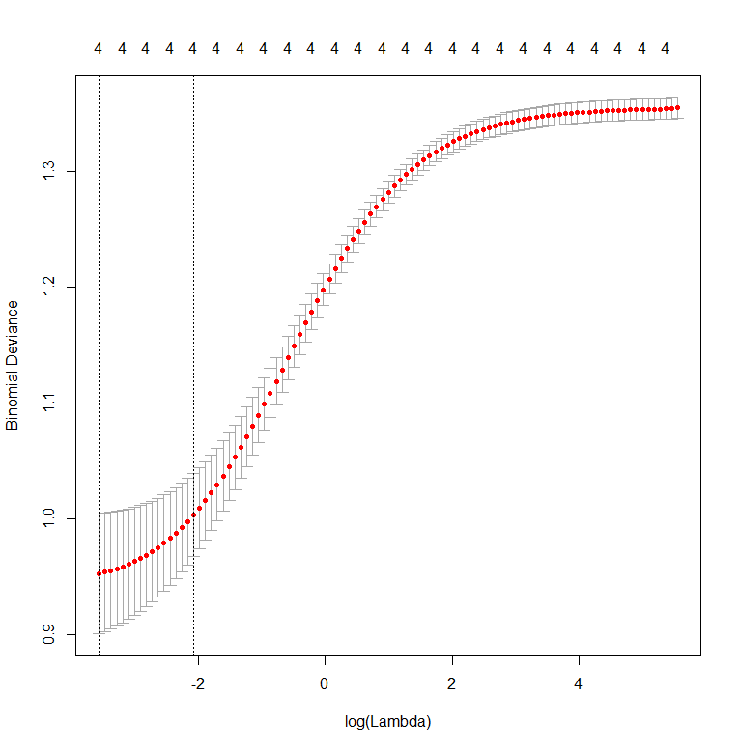
Data Analysis – cv.lasso.model

Slide 24
Data Analysis – setup prediction models
# get the ROC curve of the cross-validated Ridge model
auc.cv.ridge.model <- cv.glmnet(x = as.matrix(traindata.factored[,2:5]), y = as.matrix(traindata.factored[,1]), family="binomial", alpha=1, type.measure="auc")
ridge.test.prob <- predict(auc.cv.ridge.model, type="response", newx = as.matrix(testdata.factored[,2:5]), s = 'lambda.min')

Slide 25
Data Analysis – AUC performance
# predict the test data on whether someone survived or not
ridge.pred.auc <- prediction(ridge.test.prob[,1], testdata.factored[,1])
# obtain the false positive and true positive rate of the prediction
cv.ridge.auc.fp <- slot(ridge.pred.auc, "fp")
cv.ridge.auc.tp <- slot(ridge.pred.auc, "tp")
cv.ridge.fpr <- unlist(cv.ridge.auc.fp) / unlist(slot(ridge.pred.auc, "n.neg"))
cv.ridge.tpr <- unlist(cv.ridge.auc.tp) / unlist(slot(ridge.pred.auc, "n.pos"))
cv.ridge.perf.auc = performance(ridge.pred.auc, "auc")
cv.ridge.auc <- cv.ridge.perf.auc@y.values[[1]]
# plot the ROC curve
plot(cv.ridge.fpr, cv.ridge.tpr, main="ROC Curve from cross-validated Ridge regression", xlab="False Positive Rate", ylab="True Positive Rate")
# label the AUC on the plot for easy viewing
text(0.4, 0.6, paste("Ridge AUC = ", format(cv.ridge.auc, digits=5, scientific=FALSE)))

Slide 26
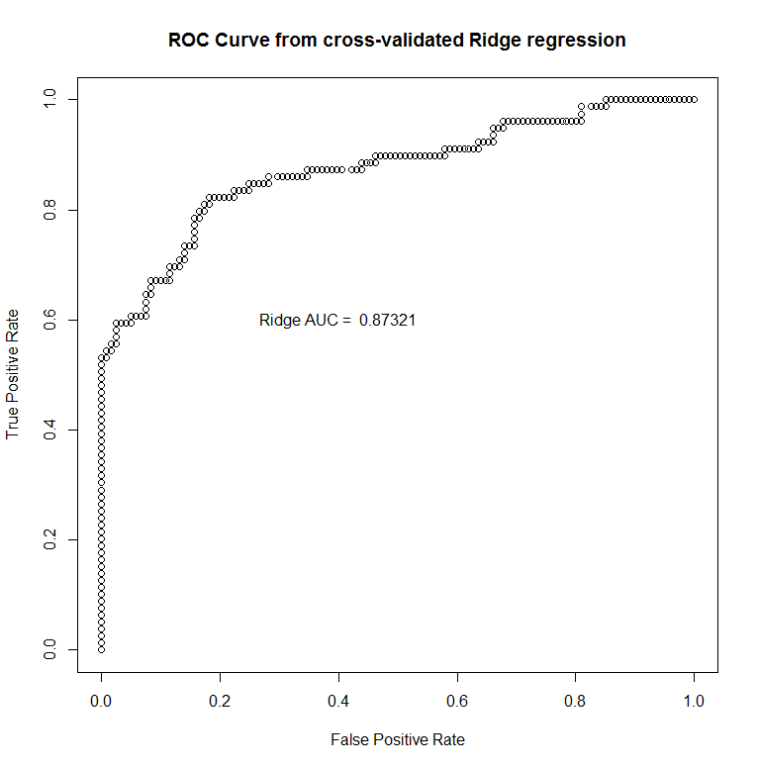
Data Analysis – AUC for auc.ridge.lasso.model

Slide 27
Elastic Net

Slide 28
Data Analysis – Elastic Net models
# get the Elasticnet model
# NOTE: alpha=0.5 (alpha=1 in LASSO, alpha=0 in Ridge)
elasticnet.model <- glmnet(as.matrix(traindata.factored[,2:5]), as.matrix(traindata.factored[,1]), family="binomial", alpha=0.5)
# get cross-validated Elasticnet model to estimate the optimal lambda
cv.elasticnet.model <- cv.glmnet(as.matrix(traindata.factored[,2:5]), as.matrix(traindata.factored[,1]), family="binomial", alpha=0.5)
# estimated optimal lambda
cv.elasticnet.model$lambda.min # 0.004084106

Slide 29
Data Analysis – viewing model plots
plot(elasticnet.model, label=TRUE)

Slide 30
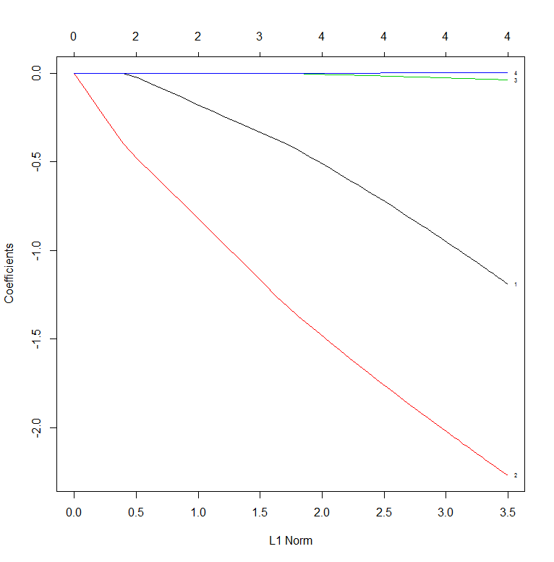
Data Analysis – elasticnet.model

Slide 31
Data Analysis – viewing model plots
plot(cv.elasticnet.model)

Slide 32
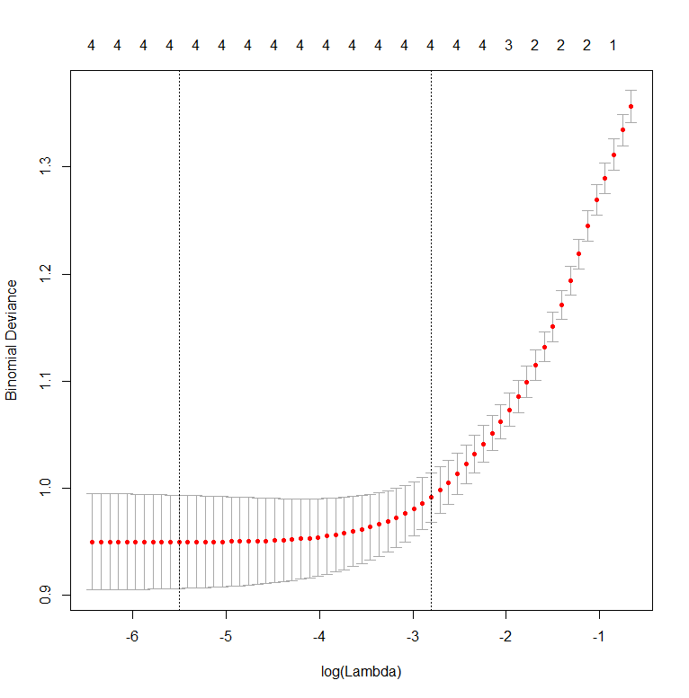
Data Analysis – cv.lasso.model

Slide 33
Data Analysis – setup prediction models
auc.cv.elasticnet.model <- cv.glmnet(x = as.matrix(traindata.factored[,2:5]), y = as.matrix(traindata.factored[,1]), family="binomial", alpha=1, type.measure="auc")
elasticnet.test.prob <- predict(auc.cv.elasticnet.model, type="response", newx = as.matrix(testdata.factored[,2:5]), s = 'lambda.min')

Slide 34
Data Analysis – AUC performance
# predict the test data on whether someone survived or not
elasticnet.pred.auc <- prediction(elasticnet.test.prob[,1], testdata.factored[,1])
# obtain the false positive and true positive rate of the prediction
cv.elasticnet.auc.fp <- slot(elasticnet.pred.auc, "fp")
cv.elasticnet.auc.tp <- slot(elasticnet.pred.auc, "tp")
cv.elasticnet.fpr <- unlist(cv.elasticnet.auc.fp) / unlist(slot(elasticnet.pred.auc, "n.neg"))
cv.elasticnet.tpr <- unlist(cv.elasticnet.auc.tp) / unlist(slot(elasticnet.pred.auc, "n.pos"))
cv.elasticnet.perf.auc = performance(elasticnet.pred.auc, "auc")
cv.elasticnet.auc <- cv.elasticnet.perf.auc@y.values[[1]]
# plot the ROC curve
plot(cv.elasticnet.fpr, cv.elasticnet.tpr, main="ROC Curve from cross-validated Elastic Net regression", xlab="False Positive Rate", ylab="True Positive Rate")
# label the AUC on the plot for easy viewing
text(0.4, 0.6, paste("Elastic Net AUC = ", format(cv.elasticnet.auc, digits=5, scientific=FALSE)))

Slide 35
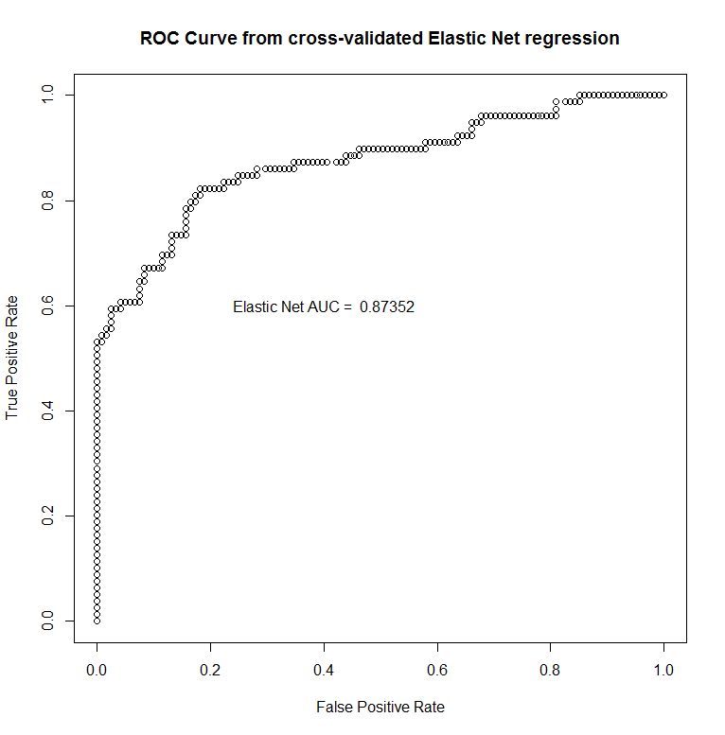
Data Analysis – AUC for auc.cv.lasso.model

Slide 36
Conclusion
Useful for feature selection when there is a large number of features
Cross-Validated models performed almost equally across all algorithms
Adjusting the lambda value might show improvements between the different algorithms
Including more features might show improvements in the results of the Elastic Net algorithm over the other two
Elastic Net DOES NOT always perform better than LASSO Regression
It did perform better than Ridge Regression in this scenario

